Slide 1
C programming
Ms. Nazira Shaikh
Cantilever Labs

Slide 2
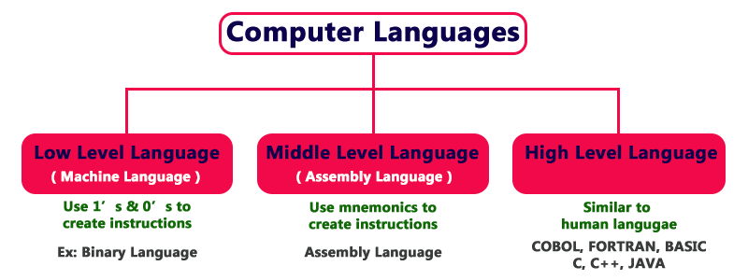

Slide 3
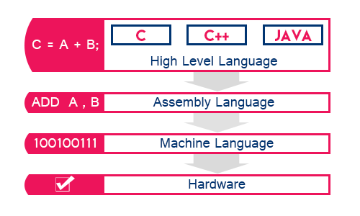

Slide 4
Translators
Assembler (Assembly -> Machine)
Compiler (High -> Machine)
Interpreter (High -> Machine)
Compiler searches all the errors of program and list them. If program is error free then it converts the code into machine code and executed further

Slide 5
Features of C programming
Procedural language:
Everything in C is a procedure/function
High level language:
It makes programming simpler for human beings at the same time allows us to access system level features like
- Direct memory access through pointers
- Bit manipulation using bitwise operators
- Writing assembly codes within C code
Because of these unique features C becomes popular choice to write system level applications like kernels, device drivers, operating systems &
various software applications like games, editors and other graphic rich applications

Slide 6
Structure of C programs
Comments
Pre-processor directives
Global variables
int main (void)
{
local variables
statements
…….
…….
return 0;
}
func1()
{
local variables
statements
…….
}
func2()
{
local variables
statements
…….
}
- /* specify your comment */
- Can be placed anywhere in the program
- Used for documentation purpose
- Ignored by the compiler
Preprocessor directives are passed through pre-processor
before C source code passes through compiler
- What is preprocessor?
Replaces text (starting with #) with the actual content
ex. #include <stdio.h> : pre-processor replaces this line by the stdio.h file
Output of pre-processor is expanded source code

Slide 7
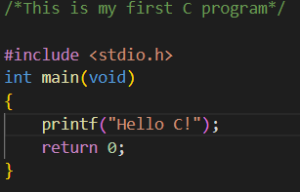

Slide 8
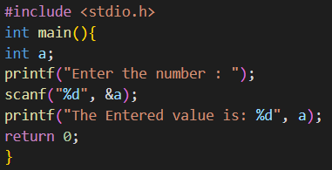
Input and Output in C
printf()
scanf()

Slide 9
Elements of C
Keywords
Identifier
Datatypes
Constants
Variable declaration
All of these are used to construct the C program

Slide 10
Keywords
These are reserved words which has predefined meaning.
They are always written in lowercase
There are 32 keywords in C
auto | break | case | char
const | continue | default | do
double | else | enum | extern
float | for | goto | if
int | long | register | return
short | signed | sizeof | static
struct | switch | typedef | union
unsigned | void | volatile | while

Slide 11
Identifier
Everything in C is either a keyword or an Identifier.
Keywords are predefined and cant be changed by the user while identifiers are user defined words that are used to give names to entities like variable, arrays, functions, structures etc.
Rules for naming identifiers:
Can contain a-z, A-Z, 0-9 but should not start with a number
No special characters are allowed except _
Beginning with a underscore “_” is valid but not advisable
As C is case sensitive the uppercase and lowercase letters are considered different (ex Code is different from code)
Identify if below given Identifiers are valid/Invalid
Rec#
1rec
_data
avg no
int

Slide 12
Datatypes
A datatype defines a domain of allowed values and operations that can be performed on those values
There are 4 fundamental datatypes in C
int : used to store integer values
char : used to store any single character
float : used to store single precision floating point number
double : is used for storing double precision floating point number
There are 2 types of qualifiers
1. size qualifier – short, long
2. sign qualifier – signed, unsigned

Slide 13
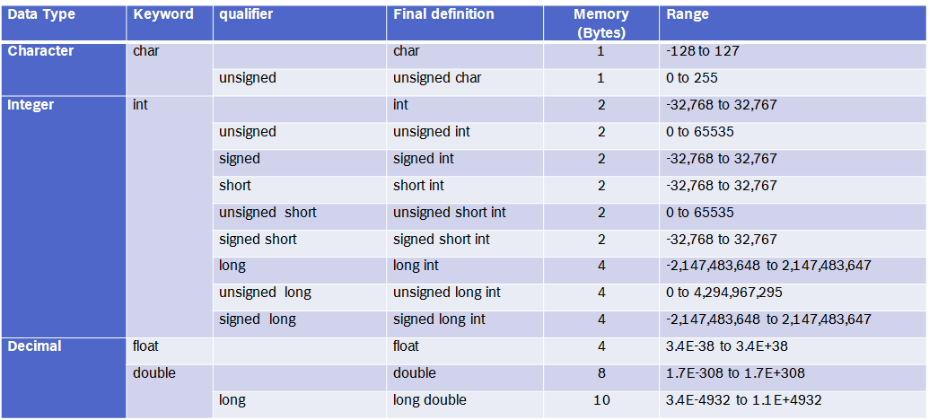
Note: size and range of different data types depends on the machine and compiler
- All character and integer are known as integral types and float, double, long double are known as floating point type.

Slide 14
WAP to find size and limits of data types
Tips:
- sizeof operator
- Range of integral types is given in limits.h & precision for floating point types is given in float.h
SCHAR_MIN, SCHAR_MAX, UCHAR_MAX
SHRT_MIN, SHRT_MAX, USHRT_MAX
INT_MIN, INT_MAX, UINT_MAX
LONG_MIN, LONG_MAX, ULONG_MAX
FLT_MIN,FLT_MAX
DBL_MIN, DBL_MAX
LDBL_MIN, LDBL_MAX

Slide 15
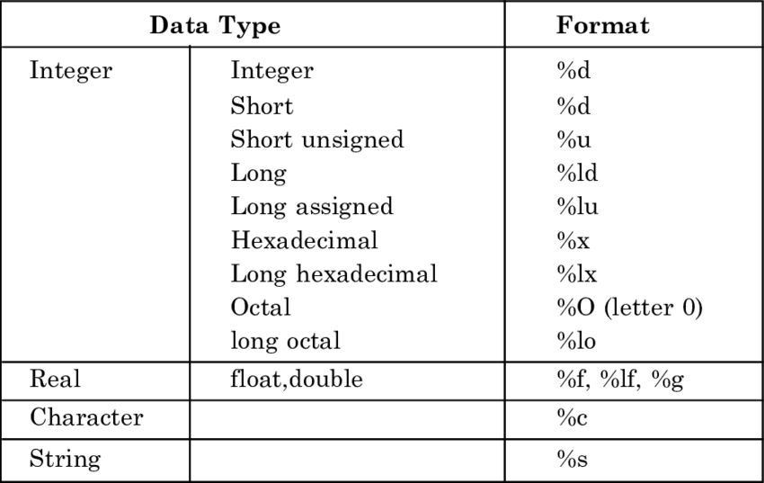
Format specifiers in C

Slide 16
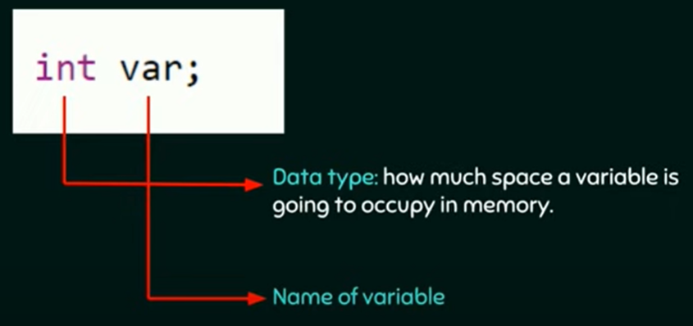
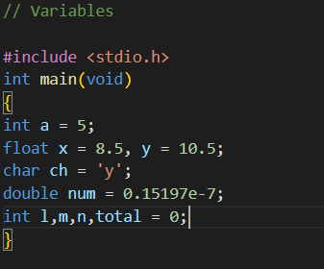
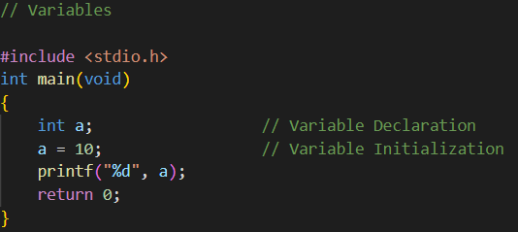
Variables
- Can store some value in it, that can be used further in program
- They are simply names that points to some memory location
- Variables should be declared before use:
10
a

Slide 17
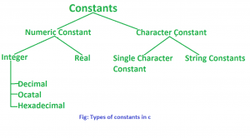
Constants
numeric constant: 1, 10, 86233, -90
Valid decimal integer constants: 0, 123, 3705, 23759
Invalid decimal integer constant: 2.5, 012256
Octal constants(starts with 0): 0, 056, 077
hexadecimal constants (starts with 0x or 0X): 0X23, 0xA125
Real/Floating point constants: 0.5, 2.59e9, 2.63E-7, 50.23
Character constants (single character enclosed in single quotes): ‘9’, ‘a’
String constants (multiple characters enclosed in double quotes): “kumar”, “593”

Slide 18
Symbolic constants:
If we want to use a constant several times, we can provide it with a name
#define name value
#define PI 3.14159265

Slide 19
Operators in C
Arithmetic operators: (+,-,*,/,%)
Assignment operators (=)
Increment and Decrement operators (++x, --x, x++, x--)
Relational operators: (<, <=, >, >=, ==, !=)
Logical operators: (&&, ||, !)
Conditional operators: (Test expression? expression1 : expression2)
Bitwise operators: (&,|, ~, <<, >>, ^)
Other operators

Slide 20
Control Statements in C:
if-else if-else
if (expression)
{
statements
}
else if (expression)
{
}
else
{
statements
}

Slide 21
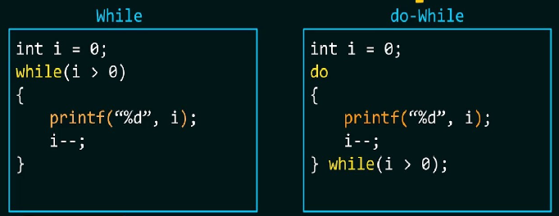
Control Statements in C:
Loops:
while
do-while
for
for (exp1; exp2; exp3)
{
statements
}

Slide 22
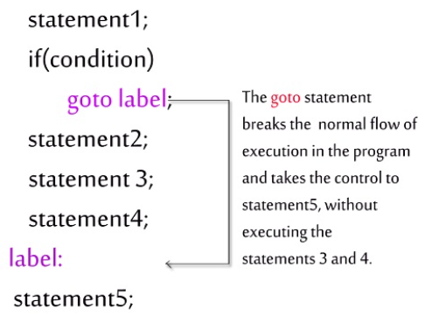
Control Statements in C:
break: throws out of the most nearest loop
continue: escapes all the statements for the current iteration written after continue statement
goto: unconditional control statement that transfers the flow of control to another part of program

Slide 23
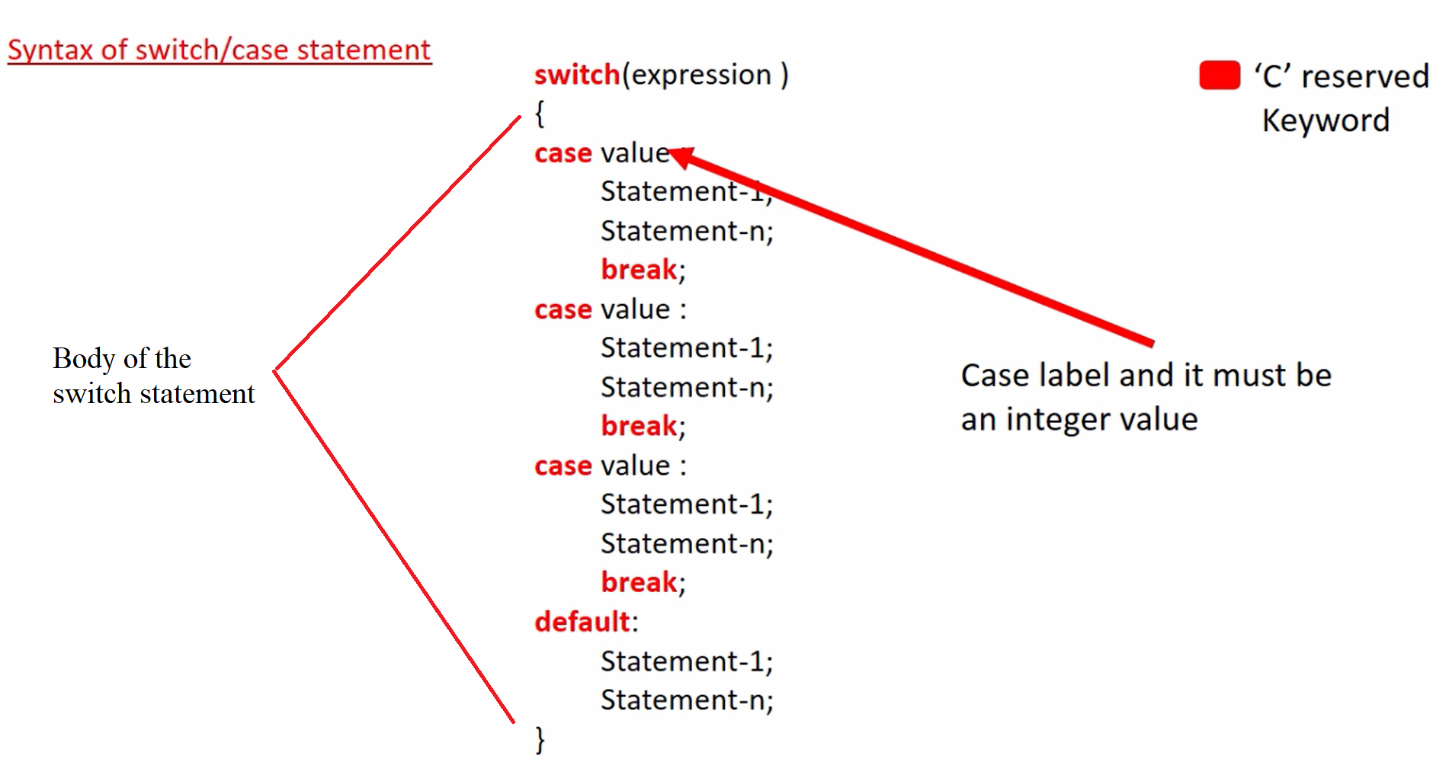
Control Statements in C:
switch-case: Multi-way conditional control statement which helps us to make choice among a number of alternatives

Slide 24
Programs to practice
WAP to print numbers from 1 to 10 using while loop
WAP to print numbers from 1 to 10 using for loop
WAP to print numbers in reverse order with a difference of 2
WAP to print numbers from 1 to 10 using do while loop
WAP to find the sum of digits of a number until the sum is reduced to 1 digit (538769 → 38 → 11 → 2)
WAP to find whether a number is prime or not
WAP to perform arithmetic calculations on integers using switch-case
WAP to find whether the alphabet is vowel or consonant

Slide 25
Functions
A function is a self-contained subprogram that performs some specific, well defined task
Two types of functions in C:
Library functions: sqrt(), printf(), scanf()
User defined functions: To create and use these functions, we should know about these 3 things
Function declaration
Function definition
Function call
# If definition is placed before declaration then declaration is not needed
WAF that takes an input number and returns the reverse of the number (1234→ 4321)
WAF to check if a number is palindrome
WAF that inputs two numbers and prints all the prime numbers between those numbers

Slide 26
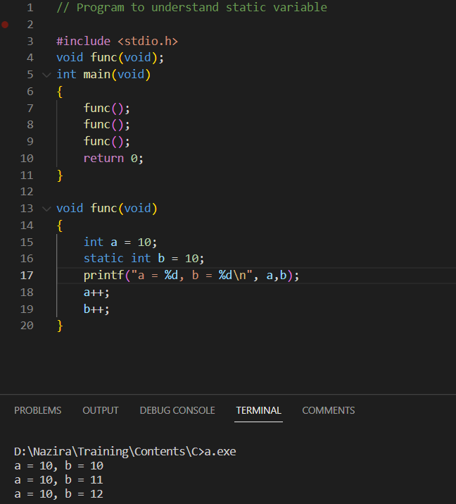
Local, Global & Static variables
Local variables: The variables whose scope is within
the body of the function it is defined in
Global variables: The variables that are defined outside any
function (even main function).
Global variables are automatically
initialized to 0 at the time of declaration
Static variables: These are declared by writing keyword static infront
of the declaration.
If static variable is not initialized then it is automatically
initialized with 0.
A static variable is initialized only once and its value is
retained between function calls
static type var_name

Slide 27
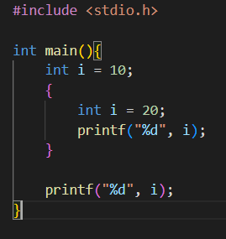
Scope of a variable within block

Slide 28
Variable modifers
Auto
Extern
register

Slide 29
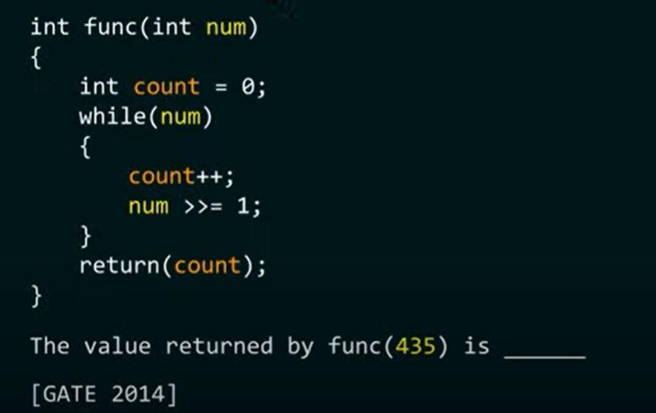
Practice problems

Slide 30
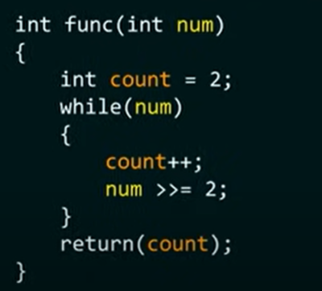

Slide 31
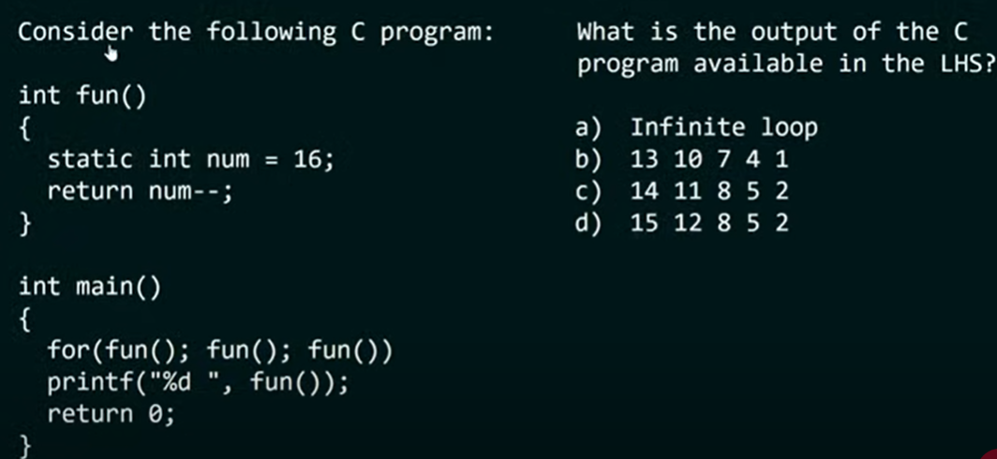

Slide 32
Array
An array is a collection of elements of similar datatype
Array can be single or multi-dimensional
1-D Array:
Declaration of array:
int scores_test_1[75];
float salary[15];
char grade[20];
Note: When array is declared, the compiler allocates space in memory sufficient to hold all elements of the array, hence we can never use variables for specifying the size of array
Sizeof operator can count the number of elements in the array sizeof(name_of_array)/sizeof(name_of_array[0])

Slide 33
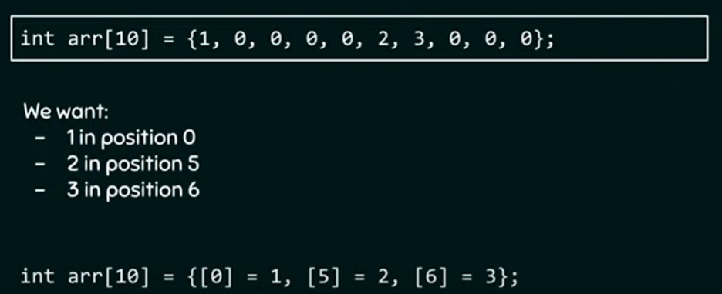
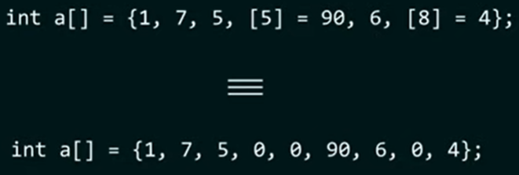
Initialization of 1-D array
int marks[5] = {10,50,65,25,89};
if size is omitted during array initialization, then compiler assumes size to be equal to number of elements
If the number of initializers is less than the size of array, then all remaining elements are assigned 0 value
We cannot copy an array by just assigning it to another variable, we have to copy each element of array one by one
Designated Initialization of an array
Array elements can be accessed using arr[0], arr[1] …….
Combination
Note: If there is a clash then designated initializer will win

Slide 34
Programs to practice on 1-D Arrays
WAP to input values into an array and display them
WAP to add elements of an array
WAP to find largest and smallest number in an array
WAP to reverse the array
WAP to search for an element in array using linear search
WAP to search for an element in array using binary search
WAF which finds the smallest element of the array and swaps it with the 0th element of the array
WAP to sort the elements of 1-D array in ascending order through selection sort
WAP that scans a 1D array from left to right and compares all adjacent elements . Any two adjacent elements arr[j] and arr[j+1] should be exchanged if arr[j] is greater than arr[j+1]. This procedure will always bring the biggest element at the last position. Count the total number of exchanges done.
WAP to sort the elements of 1D array in ascending order through bubble sort
WAP to sort the elements of 1D array in ascending order through insertion sort

Slide 35
Multidimensional array:
These are array of arrays
Declaration of 2D array
datatype array_name [rowsize] [columnsize];
Initialization of 2D arrays:
int arr[2][3] = {1,2,3,4,5,6};
int arr[2][3] = { {1,2,3}, {4,5,6}};
int arr[][3] = { {1,2,3}, {4,5,6}}; // In 2D arrays its optional to specify first dimension but second is mandatory
int arr[2][3] = {{1,2}, {3,4,5}}; // remaning elements in each row is initialized with 0
Access elements of 2D array:
arr[ith row][jth c
olumn]
WAP to input and display a matrix
WAP to add two matrices
WAP to multiply two matrices
WAP to transpose a matrix

Slide 36
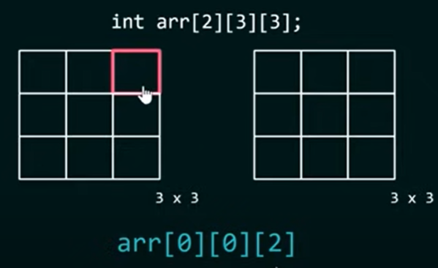
3-dimensional array

Slide 37
Pointers
C is very powerful language and the real power of C lies in pointers.
The use of pointers makes the code more efficient and compact
A pointer is a variable that stores memory address
Declare pointers
Data_type *p_name // * tells the compiler that the declared variable is a pointer
int *iptr // pointer that points to variables of type int
float *fptr // pointer that points to variables of type float
char *cptr // pointer that points to variables of type character
Initializing pointer
int *iptr,age;
iptr = &age
Dereferencing pointer variables: With Dereferencing we can access the variable pointed by the pointer
int a = 87, *p1 = &a;
float b = 4.5, *p2 = &b;
*p1 = 9 // equivalent to a = 9
(*p1)++ // equivalent to a++
(*p2)+10 // equivalent to b + 10
Note: * operator here is called indirection operator (should be read as “value at address”)

Slide 38
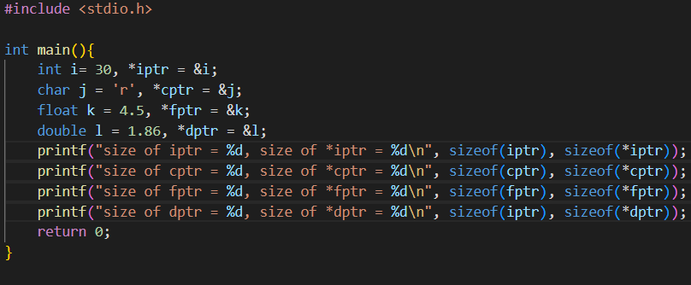
why do we mention datatype while declaring the pointer?
The value of pointer only tells the address of starting bytes, while dereferencing how many bytes should be retrieved starting from this address is told by the datatype mentioned during declaration

Slide 39
Pointer Arithmetic
Only valid operations that can be done with pointers are
1. Addition with integer to pointer and increment
2. Subtraction of an integer from a pointer and decrement operation
3. Subtraction of a pointer from another pointer of same type
#Note: Pointer arithmetic is performed relative to the size of base type of pointer
Eg: int *pi,i;
pi = &i; //1000
pi++; //1004 (assuming size of int datatype is 4)
char a = ‘x’, *pc=&a;
int b=5, *pi=&b;
double c = 456.456, *pd=&c;
//suppose address of a,b,c is 1000,4000,5000 find the below
pc++
pc=pc-3
pc=pc+5
pi++
pi=pi-3
pi=pc+5
pd++
pd=pd-3
pd=pd+5

Slide 40
Pointer Comparision: All relational operators can be used with pointers
Pointer to pointer:
We know that pointer is a variable that can contain memory address. This pointer variable takes some space in memory and hence it also has an address. We can store the address of a pointer variable in some other variable, which is known as pointer to pointer variable. This concept can be extended further to any limit, but in practice only pointer to pointer is used
This is generally used while passing pointer variables to functions
Syntax: datatype **pptr
Ex:
int a = 5;
int *pa = &a;
int **ppa=&pa
Deferencing pointer to pointer (Program)

Slide 41
Pointer and 1D Array:
When the name of an array is used in any expression, it is implicitly converted to a pointer to the first element of array
WAP to print the value and address of the elements of an array
WAP to print the value and address of the elements of an array using pointer notation
Array subscripting is commutative
i.e arr[i] is same as i[arr] //Subscript notation
i.e *(arr+i) is same as *(i+arr) // Pointer notation
Array Pointer:
Pointer that can point to entire array instead of first element of array.
Syntax:
int (*ptr)[10];
WAP to verify the same
On dereferencing array pointer, we get base address of the array to which it points

Slide 42
Strings
There is no separate datatype for strings in C, they are treated as arrays of type char.
A character array is a string if it ends with null character (‘\0’). This null character is an escape sequence with ASCII value 0, and is different from ASCII character 0.
String Constants:
A string constant is a sequence of characters enclosed in double quotes
“V”
“Opera house”
“2356”
“” // Null string
“the number is %d” //Control string used in printf
Whenever a string constant is written in program, it is stored somewhere in memeory as an array of characters terminated with a null character(‘\0’)

Slide 43
C - 24 Hours
1 : C Programming Methodology, Coding Approaches, C Standards, Programming . Syntax Techniques
2 : Decision Making and Branching, CUI and Menu Driven Programming in C Lang, Iterative Process using Loops. Syntax Techniques
3 : Homogeneous Data Types and working Array 1D 2D Numeric and Character . Syntax Techniques
4 : Modular Programming using Functions, Understanding Value Type and Ref Type Memory Blocks. Syntax Techniques
5 : Implementing Random Memory Access. Working with Pointers. Syntax Techniques
6 : Implementing Pointers in Functions, Arrays, Understanding pointer based Memory References. Syntax Techniques
7 : Understanding Object Based Methodology. Implementing Structure. Struct Array, Nested Structures. Syntax Techniques
8 : Struct Pointer, Struct with Functions, Union and Use of Union. Syntax Techniques

